Slide 1




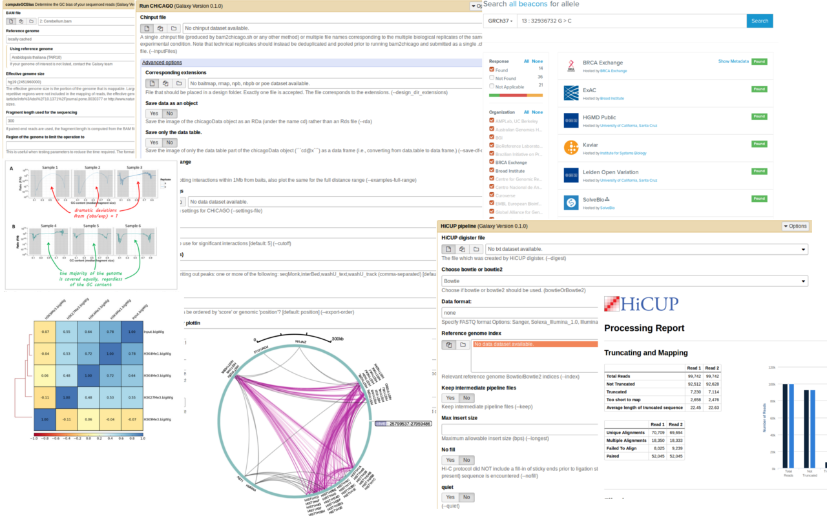
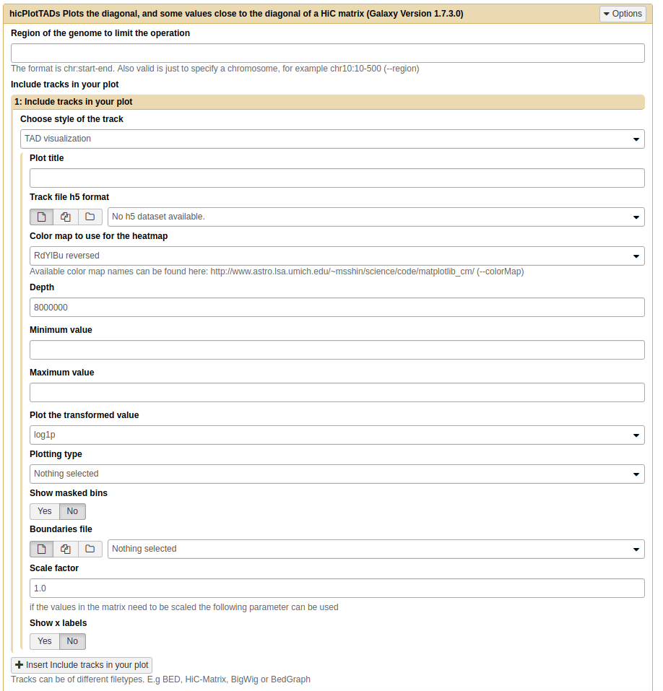
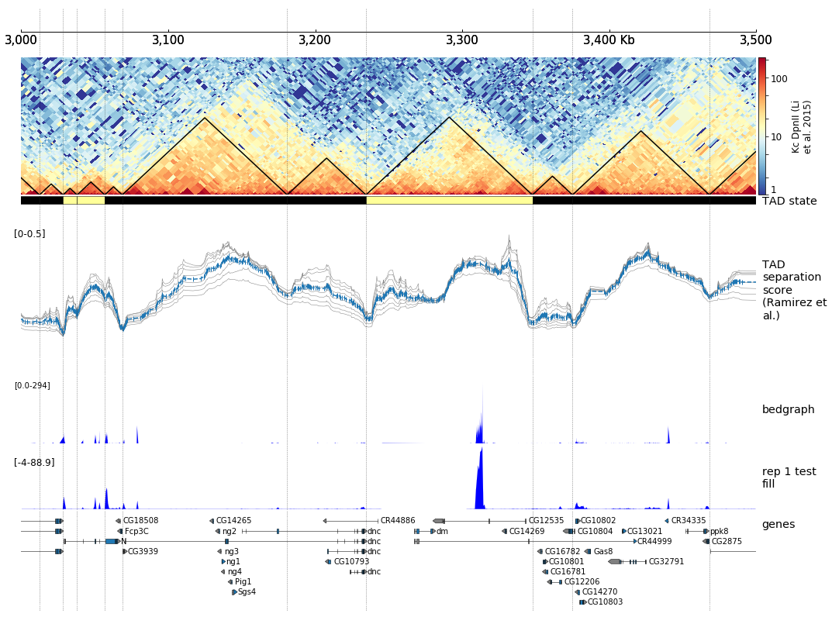



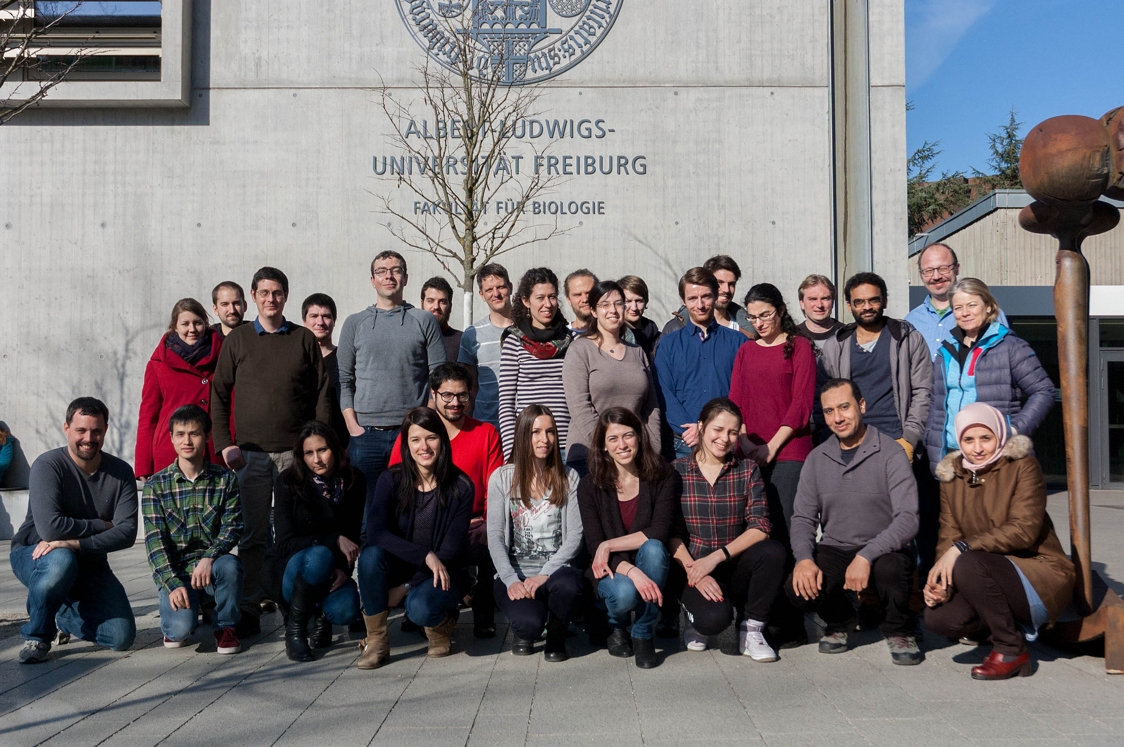
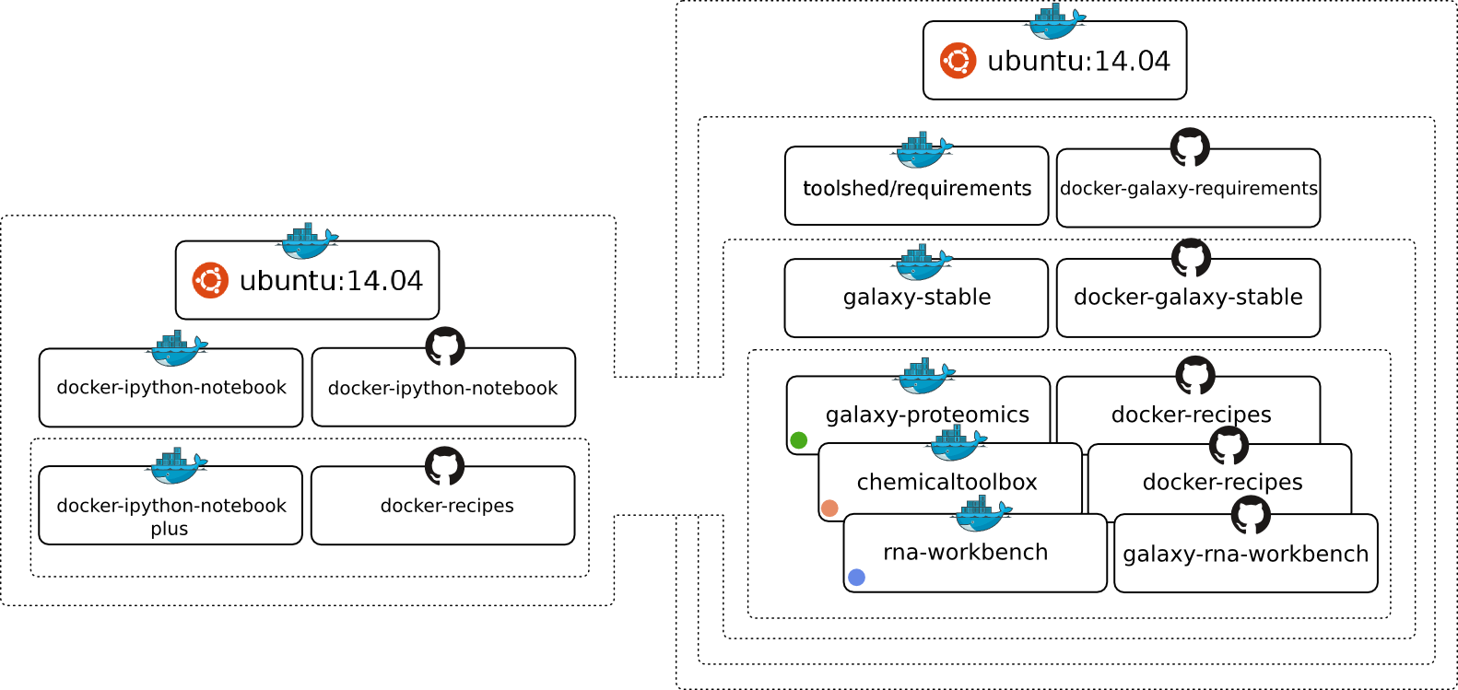

de.NBI-epi
RNA Bioinformatics Center
University of Freiburg
Chair of Bioinformatics
Fkz 031L0101C
Björn Grüning, Joachim Wolff
University of Freiburg, Germany
Description of de.NBI-epi
de.NBI services
The de.NBI-epi project in Freiburg offers:
Visualization, normalization and quality assessment:
Hi-C data analysis
MethylC-Seq data analysis
ChIP-Seq
Bisulfite sequencing analysis pipelines
Training and user support:
Galaxy HTS data analysis workshops
Self learning material on training.galaxyproject.org
Direct user support via gitter, GitHub or guest researcher
Available on:
All in one Gateway: https://galaxy.uni-freiburg.de
Your computer with virtualised and personalised instances
Maintenance, development and integration of software into Galaxy to provide easy access for epigenetic analysis software:
deepTools
Bismark
HiCUP
CHiCAGO
Methyldackel
Methtools
HiCExplorer
Galaxy
Container: Docker, rkt, Singularity
Progress report
General information on the project
Development and maintenance of software for Hi-C data analysis.
HiCExplorer:
Interaction matrix creation 3x faster
Improved training material: hicexplorer.readthedocs.io
New Galaxy wrappers for a better user experience
Docker integration
Release 2.0 will have:
Python 3 support
‘Cool’ format support
A/B compartments
Improved visualization
As part of the de.NBI-epi project in Freiburg, Joachim Wolff and Björn Grüning, are working closely with the RBC, de.NBI and ELIXIR to deliver high-class services for epigenetic research.
de.NBI services
Community based infrastructure
Bioconda is a conda channel which provides software for biomedical research.
14,475 commits on GitHub
287 contributors
> 2,700 packages
BioContainers provides system-agnostic executable environments for bioinformatics software.
Based on Docker & rkt
> 2,900 Images
Automatic builds from Bioconda
Galaxy is an open, web-based platform for data intensive research.
29,588 commits
163 contributors
One of the biggest Galaxy instances available for de.NBI in Freiburg
de.NBI training and education
Hands-on training material for self-study available on training.galaxyproject.org
Introduction to HTS
RNA-Seq
ChIP-Seq
Proteomics
MethylC-Seq
...and many more!
The Galaxy Docker Project
The Galaxy Docker Image is an easy distributable full-fledged Galaxy installation, that can be used for testing, teaching and presenting new tools and features.
Portable data analysis in a box!
2016 / 2017 past events
15th – 16th Dec 2016 | Galaxy RNA-Seq analysis workshop | Freiburg
09th – 10th Jan 2017 | Online contribution fest QIIME
16th – 19th Jan 2017 | European Galaxy Developer workshop | Strasbourg
06th – 09th Feb 2017 | Galaxy Admin workshop | Melbourne
13th – 17th Feb 2017 | Galaxy HTS data analysis workshop | Freiburg
04th – 05th Apr 2017 | ELIXIR – de.NBI AAI workshop | Freiburg
22nd – 24th May 2017 | ELIXIR – training hackathon | Cambridge
18th –22nd Sep 2017 | Galaxy HTS data analysis workshop | Freiburg
2017 / 2018 planned events
06th – 07th Nov 2017 | VFU based on containers | Freiburg
08th – 12th Jan 2018 | Galaxy Admin workshop | Oslo
19th – 23rd Feb 2018 | Galaxy HTS data analysis workshop | Freiburg
Jan 2018 | Freiburg Galaxy user meeting | Freiburg
Mid 2018 | Hi-C and epigenetics workshop | Freiburg
Based on the main Galaxy Docker virtualisation, a dedicated flavor for epi-
genetics was developed: github.com/bgruening/docker-galaxy-epigenetic
Publications
High-resolution TADs reveal DNA sequences underlying genome organization in flies.
doi: 10.1101/115063
Jupyter and Galaxy: Easing entry barriers into complex data analyses for biomedical researchers.
doi: 10.1371/journal.pcbi.1005425
The RNA workbench: best practices for RNA and high-throughput sequencing bioinformatics in Galaxy
doi: 10.1093/nar/gkx409
BioContainers: an open-source and community-driven framework for software standardization
doi: 10.1093/bioinformatics/btx192
www.denbi.de

